Slide 1


Open Source Product Apache Open Office
Present By : IT17136334 A.P.S.D Gunarathna IT17146234 Kabilashan P.

Slide 2
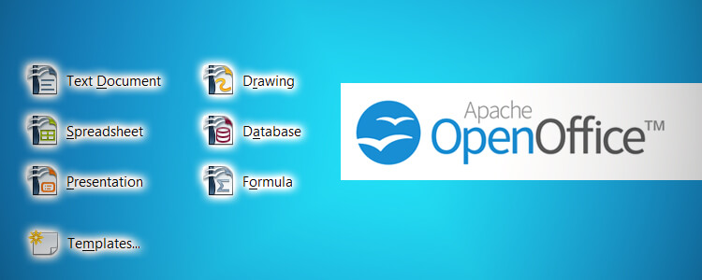
What is Apache OpenOffice?
Apache OpenOffice is the result of over twenty years' software engineering. Designed from the start as a single piece of software, it has a consistency other product cannot match. A completely open development process means that anyone can report bugs, request new features, or enhance the software. The result: Apache OpenOffice does everything you want your office software to do, the way you want it to.

Slide 3

Product assets of Apache Open Office
Apache OpenOffice Base
Base is a fully featured desktop database management system, designed to meet the needs of a broad array of users, from
just tracking your personal CD collection, to
producing a corporate monthly departmental sales report.
OpenOffice.org Base - Database Drivers
PostgreSQL
The postgresql SDBC Driver allows to use the postgresql database from OpenOffice.org without any other wrapper layer such as odbc or jdbc.
Linux MDB
This driver (which is in development) uses the MDBTools to provide (read) access to Microsoft Access files to Linux users of OpenOffice.org.
SQLite
This SDBC driver (currently in alpha state) is dedicated to giving OpenOffice.org native access to SQLite databases.

Slide 4

Vulnerability History and Sample attacks
Multiple Vulnerabilities in Apache OpenOffice Could Allow for Arbitrary Code Execution
Successfully exploiting these vulnerabilities could allow for arbitrary code execution in the context of the affected application. Depending on the privileges associated with the application, an attacker could install programs; view, change, or delete data; or create new accounts with full user rights. Failed exploitation could result in a denial-of-service condition.
Sample Attacks
Now Cisco Talos believes attackers are trying out slightly different formats that have a reputation for being overlooked by a computer’s defenses. OpenDocument files (.odt) are associated with Apache OpenOffice
Apache.OpenOffice.Text.Document.Malicious.Macro.Execution
This indicates an attack attempt to exploit a remote Code Execution vulnerability in Apache OpenOffice.The vulnerability is due to an error when the vulnerable software handles a crafted ODT file that contains malicious macros. A remote attacker may be able to exploit this to execute arbitrary code within the context of the application, via a crafted ODT file.

Slide 5

Design Analysis
Architecture Overview
The OpenOffice.org source project is based on an architecture that can provide comprehensive personal productivity to different UNIX-based systems and may be ported many other platforms as well.
This is because the whole technology is based on a platform-independent approach.
Less than 10% of the code is platform dependent.
This acts as an abstraction layer for the upper software components. Because of the availability of C++-Compilers on every major platform, C++ is used as an implementation language.
This allows to port the OpenOffice.org technology to a wide range of different platforms.
The decision for an object oriented language gives the OpenOffice.org source project the opportunity deliver a fully object oriented architecture.

Slide 6

Main functionalities of the product
OpenOffice.org is a unified suite of productivity applications for all common office applications, including such functions as word processing, spreadsheets, drawings, presentations, data charting and formula editing.
All components of the suite employ the same user interface concepts and underlying technology.
They interoperate closely with one another, supporting features like inter-application copy-and paste and drag-and-drop for creating compound documents.

Slide 7
The OpenOffice.org Component Technology
The OpenOffice.org suite provides a component technology named Universal Network Objects, which adheres to all these requirements of modern Component Ware and it is formed on the Object Technology level, which is the basis upon which the OpenOffice.org API is set up.
This component technology is
Open
Interface Based
Platform Independent
Exception Able
Development System Independent
Network Able
Object Oriented

Slide 8

Design Principles
•Orthogonality
The API consists of interfaces which can easily be combined to serve special needs of certain objects.
•Scalability
We distinguish between functionality that is commonly needed and that which is required by specialized versions. Developers can always start with a minimum set of interfaces and add more step by step to embody more features.
•Reusability
We avoid creating specialized interfaces when a generic version is possible.
•Remote usability
Services can be used efficiently from different processes or even different machines.
•Multithread enabled
Services can be used from multiple threads.

Slide 9

Security Concepts for Open Office
Encryption
Public Key Document Encryption
It would be a nice feature to allow public key encryption for encrypting documents. People could encrypt the documents with their own and/or with other people's public key certificates, so only the owners of the corresponding private keys would be able to open the document. No need to exchange or remember passwords.
Password length and password pattern
The ancient minimal password length in the password dialogue should be removed, but don't allow empty passwords. (issue #i103783)
Ooo-password-properties:
MinPasswordLength (default=1 if not set)
MinNumbercharacters
MinSpecialCharacters
ForbiddenCharacters.
We would then also need some dialogue which explains the password rule to the user.

Slide 10
Document Integrity
The best way to ensure document integrity is to digitally sign the documents.
But most people won't do it, or even don't have the infrastructure for this, so there should be some light weight mechanism for checking the document integrity
Digital Signatures
Document files and package files, that is the files which carry meta information for the package, such as manifest.xml,
Digital signatures are stored in one or more files within the META-INF folder. The names of these files shall contain the term "signatures".

Slide 11

Hardened Office Installation
The idea about a "Hardened Office Installation" came up in discussions with Eric Filiol & Jean-Paul Fizaine.
In a special installation/configuration, more security features and more security checks might be available.
This list include things like
Digital Signatures also for application macros installed with OOo (currently digital signatures are only used for macros in documents)
Do not install additional scripting engines, like python for example
Lock certain user configuration, like macro security level
Add hash values in all ODF documents, check on loading
Digital Signatures also for application macros
This is mainly to stop easy to achieve viral effects.

Slide 12

Apache OpenOffice is a free and open source suite of productivity tools that assist companies, businesses, and professionals in managing their writing projects, streamlining their document management tasks, and collecting and manipulating valuable data efficiently and is the leading open-source office software suite for word processing.
The OpenOffice.org source project is based on an architecture that can provide comprehensive personal productivity to different UNIX-based systems and may be ported many other platforms as well.
After carrying out a series of trial and code inspection it can be conclude that the open office platform is possible to gain accessed by attackers due to the weaknesses of the system. Although this product is open for any developer this should be consider about the security aspects of the software as well. So, It will causes to gain more user attention to the product.

Slide 13

Note : To get more information about Apache Open Office please visit our document.

